Slide 1
Model Evaluation
Evaluation Metrics for Prediction and Classification

Slide 2
Overview
Need for model evaluation
Evaluation Metrics for Prediction(Regression) models
Evaluation Metrics for Classification models
Asymmetrical Costs of (mis)classification
Alternate Evaluation Measures for Classification models

Slide 3
Why do we need to evaluate models?
Multiple ML algorithms applicable to classification/prediction
Wide choice of parameter and/or hyperparameter settings possible in these algorithms
Hence the need to evaluate each model’s performance
In all cases, performance to be evaluated on validation/test data (to avoid wrong interpretations from overfitting on training data)

Slide 4
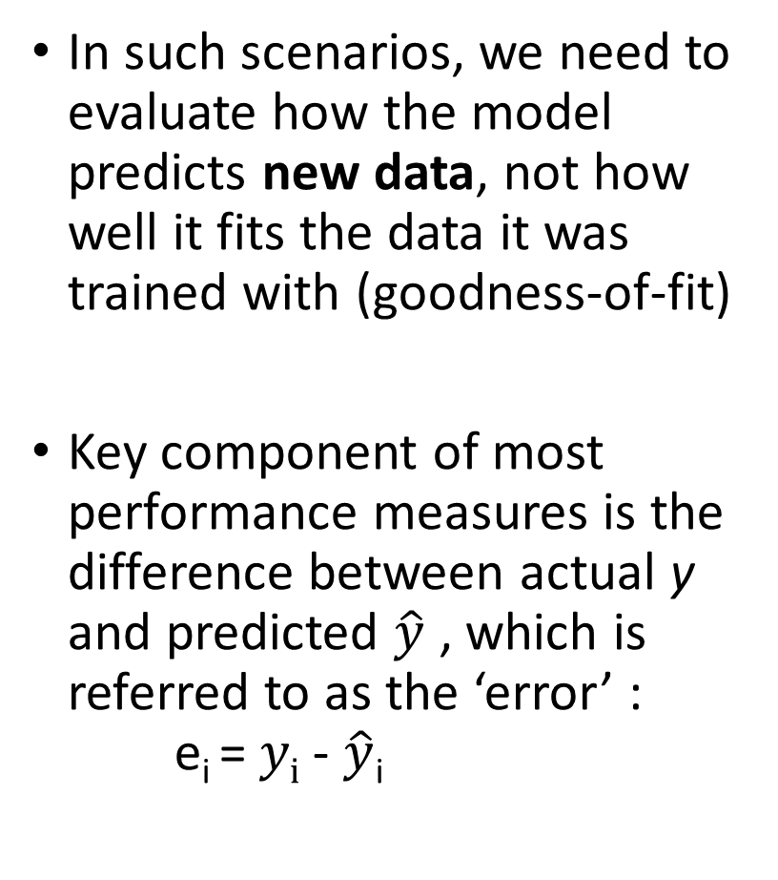
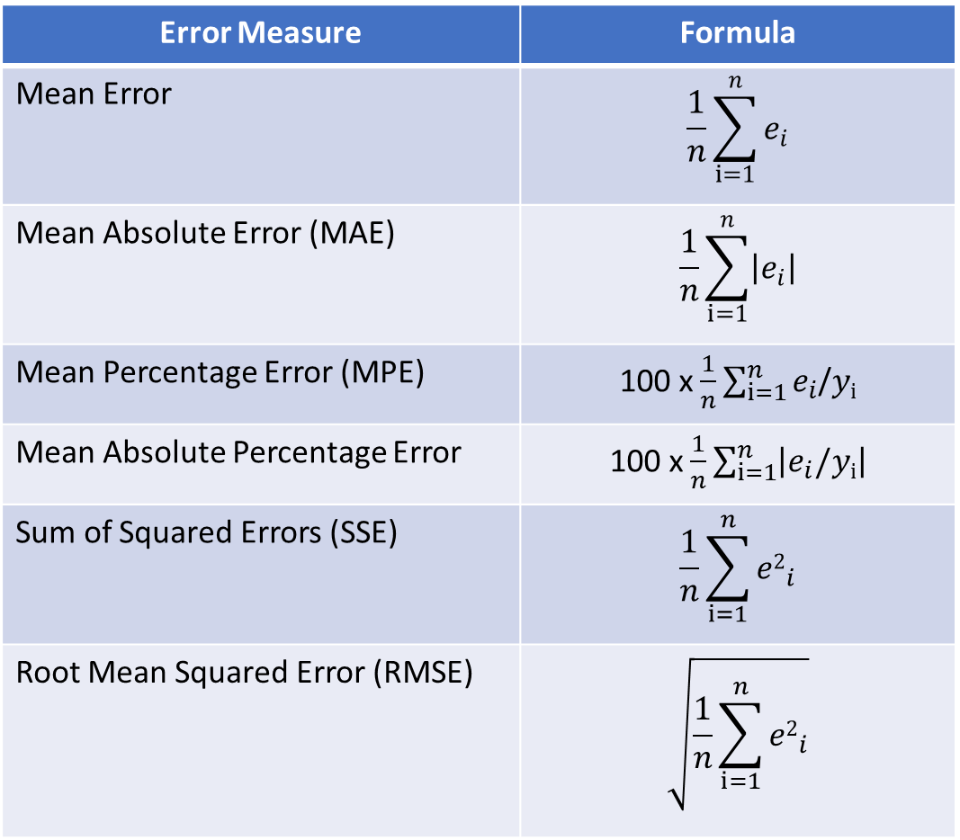
Evaluating performance in Prediction
In such scenarios, we need to evaluate how the model predicts new data, not how well it fits the data it was trained with (goodness-of-fit)
Key component of most performance measures is the difference between actual y and predicted $\hat{y}$ , which is referred to as the ‘error’ : e_{i} = $yi$ - $\hat{y}$_{i}
Error Measure | Formula
Mean Error | $$\frac{1}{n}\sum_{i=1}^{n}{e_{i}}$$
Mean Absolute Error (MAE) | $$\frac{1}{n}\sum_{i=1}^{n}{\left|e_{i}\right|}$$
Mean Percentage Error (MPE) | 100 x $\frac{1}{n}\sum_{i=1}^{n}{e_{i}}$/$yi$
Mean Absolute Percentage Error | 100 x $\frac{1}{n}\sum_{i=1}^{n}{\left|e_{i}/yi\right|}$
Sum of Squared Errors (SSE) | $$\frac{1}{n}\sum_{i=1}^{n}{{e2}_{i}}$$
Root Mean Squared Error (RMSE) | $$\sqrt{\frac{1}{n}\sum_{i=1}^{n}{{e2}_{i}}}$$

Slide 5
Evaluating performance in Classification
Most Classification algorithms classify via a 2-step process:
For each record,
Compute probability of belonging to class ‘1’
Compare to cutoff value, and classify accordingly
(Default cutoff value is 0.50, If >= 0.50, classify as “1”, If < 0.50, classify as “0”)
Can use different cutoff values and accordingly the classification output varies
Error = classifying a record as belonging to one class when it actually belongs to another class.
Error rate = percent of misclassified records out of the total records in the validation/test data

Slide 6
Confusion Matrix
Actual Class
C₁
C₂
n _{1, 1} = number of C₁ records classified correctly as C₁
n _{2, 1} = number of C₂ records classified incorrectly as C₁
C₁
Predicted Class
n _{1, 2} = number of C₁ records classified incorrectly as C₂
n _{2, 2} = number of C₂ records classified correctly as C₂
C₂

Slide 7
When One Class is More Important & misclassification costs are asymmetrical
In most cases it is more important to identify members of one class
Diagnosing illness (Illness)
Detecting SPAM mail (Spam mails)
Credit default (Potential Defaulter Class)
Tax fraud (Fraudulent Tax Class)
Response to promotional offer (Respondent Class)
Detecting electronic network intrusion (Malicious Packet class)
Predicting delayed flights (Delayed flights)
In such cases, we are willing to tolerate greater overall error, in return for better identifying the important class for further attention
The cost of making a misclassification error may be higher for one class than the other(s)

Slide 8
Asymmetrical Costs – Response to Promotional Offer
Suppose we send an offer to 1000 people, with 1% average response rate (“1” = response, “0” = nonresponse)
“Naïve rule” (classify everyone as ‘0') has error rate of 1% (seems good)
Let’s assume that by using some ML model
We can correctly classify eight 1’s as 1’s
It comes at the cost of misclassifying twenty 0’s as 1’s and two 1’s as 0’s.
Error rate = (2+20) = 2.2% (higher than naïve rate)
 | Actual 1 | Actual 0
Predicted 1 | 8 | 20
Predicted 0 | 2 | 970
Suppose: Profit from a ‘1’ is $10 & Cost of sending offer is $1
Under naïve rule, all are classified as “0”, so no offers are sent: no cost, no profit
Under ML predictions, 28 offers are sent.
8 respond with profit of $10 each
20 fail to respond, cost $1 each
972 receive nothing (no cost, no profit)
Net profit = $60
 | Actual 1 | Actual 0
Predicted 1 | 80$ | -20$
Predicted 0 | 0 | 0
Thus, we need to look beyond the traditional error/accuracy metrics in classification scenarios
Ref: Shmueli et al,Data Mining for Business Analytics: Concepts, Techniques and Applications in Python, Wiley, 2019

Slide 9
Alternate Accuracy Measures
Actual Class
C₁
C₂
n _{1, 1} = number of C₁ records classified correctly as C₁
n _{2, 1} = number of C₂ records classified incorrectly as C₁
If “C₁” is the important class,
Sensitivity (also called “recall) = % of actual C₁ class correctly classified
n _{1, 1} / (n _{1, 1} + n _{1, 2})
Ability of the classifier to detect the important class members correctly.
Also referred to as True Positive Rate, TPR = TP/ (TP + FN)
C₁
Predicted
Class
True Positive (TP)
False Positive (FP)
n _{1, 2} = number of C₁ records classified incorrectly as C₂
n _{2, 2} = number of C₂ records classified correctly as C₂
C₂
False Negative (FN)
True Negative (TN)

Slide 10
Alternate Accuracy Measures
Actual Class
C₁
C₂
If “C₁” is the important class,
Specificity = % of actual C₂ class correctly classified
n _{2, 2} / (n _{2, 1} + n _{2, 2})
Ability of the classifier to rule out the other class members (C₂) correctly.
Also referred to as True Negative Rate, TNR = TN / (FP + TN)
False Positive Rate (FPR) = 1- Specificity
FPR = FP / (FP + TN)
n _{1, 1} = number of C₁ records classified correctly as C₁
n _{2, 1} = number of C₂ records classified incorrectly as C₁
C₁
Predicted
Class
True Positive (TP)
False Positive (FP)
n _{1, 2} = number of C₁ records classified incorrectly as C₂
n _{2, 2} = number of C₂ records classified correctly as C₂
C₂
False Negative (FN)
True Negative (TN)

Slide 11
Alternate Accuracy Measures
Actual Class
If “C₁” is the important class,
Precision= % of predicted C₁ that are actually C₁
n _{1, 1} / (n _{1, 1} + n _{2, 1})
TP/ (TP + FP)
Recall (also called “sensitivity”) = % of actual C₁ class correctly classified
n _{1, 1} / (n _{1, 1} + n _{1, 2})
TP/ (TP + FN)
F-Measure provides a way to combine both precision and recall into a single measure that captures both properties. Also know as F-Score or F1-Score
F1-Score= (2*Precision*Recall) /(Precision + Recall)
Common metric used on classification problems on imbalanced datasets.
C₁
C₂
n _{1, 1} = number of C₁ records classified correctly as C₁
n _{2, 1} = number of C₂ records classified incorrectly as C₁
C₁
Predicted
Class
True Positive (TP)
False Positive (FP)
n _{1, 2} = number of C₁ records classified incorrectly as C₂
n _{2, 2} = number of C₂ records classified correctly as C₂
C₂
False Negative (FN)
True Negative (TN)

Slide 12
Summary
Evaluation metrics are important for comparing across different ML models, for choosing the right configuration of a specific ML model
Metrics are computed from validation/test data
Preferred metrics for evaluating regression(prediction) : RMSE
Confusion Matrix forms the basis for evaluation in classification scenarios
Asymmetric Costs of Mis-classification and need to go beyond error rate
Metrics for evaluation in Classification generated from Confusion Matrix: Sensitivity, Specificity, Precision, Recall, F1 Score, etc.

Slide 13
References
https://www.analyticsvidhya.com/blog/2019/08/11-important-model-evaluation-error-metrics/
https://medium.com/analytics-vidhya/complete-guide-to-machine-learning-evaluation-metrics-615c2864d916
https://python-data-science.readthedocs.io/en/latest/evaluation.html

